Slide 1

Department of Electronics & Communication Engineering
TOPIC: "FPGA Implementation of Rate 1/2 Convolutional Encoder for UART Based Serial Data Transmission"
NAME | USN
Ibrahim Affan | 4SO24EC046
Kaushik N(Leader) | 4SO24EC058
Kruthi Kundalpady | 4SO24EC060
Lereina Reemal Pashan | 4SO24EC061

Slide 2
Problem Statement:
Digital data transmitted over noisy wireless channels — such as in Bluetooth, satellite, and rural communication systems — is highly susceptible to bit errors, leading to data corruption and communication failure. While error-control coding techniques exist to address this, software-based implementations are too slow for real-time applications. This project aims to develop a hardware-based convolutional encoder on FPGA with a real serial (UART) interface, enabling fast, reliable, and deployment-ready error correction for noisy digital communication channels.

Slide 3
Planning
April 9 – Started searching for research papers on Hamming Encoder, but we could not find any suitable papers.
April 16 – Decided to change the topic and selected Convolution Encoder after referring to other research papers.
April 20 – Started working with the selected research paper.
April 29 – Work was divided among the team members
Started working on the architecture and block diagram first.
May 2 – Project work completed and submitted.

Slide 4
Objectives:
Design and implement a rate 1/2 convolutional encoder with constraint length K = 3 using generator polynomials g1 = 111 and g2 = 101 on FPGA.
Use a UART module to take serial input data.
Implement the encoder using a shift register and XOR logic.
Convert the encoded output bits into serial form so they can be transmitted through the UART module
Test the design using simulation (Vivado).

Slide 5
Comparative Analysis
Paper | Architecture | Throughput | Area (Resource Usage) | Limitation
Paper 1 (Sun & Ding, 2012) | adix-2, Full parallel ACS, K=7 | 80 Mbps | ~316 slices, 510 LUTs | Complex memory design
Paper 2 (Wong et al., 2009) | Radix-2, Adaptive Viterbi, K=3 | Not specified | High (~866 slices) | Low error correction, no throughput data
Paper 3 (Kavinilavu et al., 2011) | Standard Viterbi, K=7 | Not specified | Moderate (~325 slices encoder) | No speed/power analysis, high I/O usage
Paper 4 (Soreng & Kumar, 2013) | Area-optimized VLSI, K=7 | Not specified | Very high (decoder ~7991 ALUTs) | Large decoder area, no throughput/power data

Slide 6
Research Gap Identification
Most existing designs optimize either speed or area, but not both together.
Power consumption analysis is missing in most of the works.
Some designs use low constraint length (K=3), which is not suitable for modern communication systems.
There is a need for a design that is balanced, efficient, and practical for FPGA implementation.

Slide 7
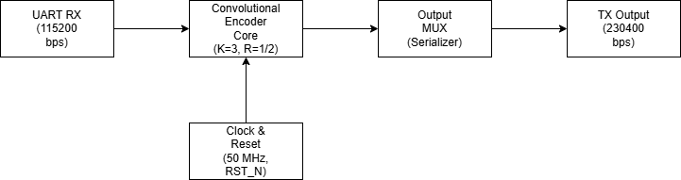
Block Diagram
By toggling sel every clock cycle, the two parallel bits come out one by one.
sel=0 → outputs n0
sel=1 → outputs n1

Slide 8
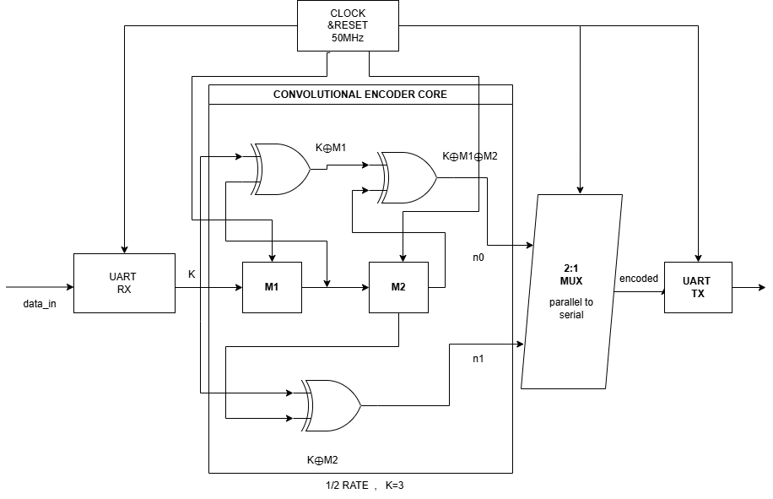
Architecture Diagram

Slide 9
Contribution of Team Members:
Kaushik N-Architecture and block diagram
Ibrahim Affan-Research paper analysis
Lereina-Leaf cell
Kruthi Kundalpady-Leaf cell
Repository Link:
https://github.com/kaushikulal/convolutional-encoder

